Slide 1
Chapter 14
Forging the national economy, 1790 - 1860

Slide 2
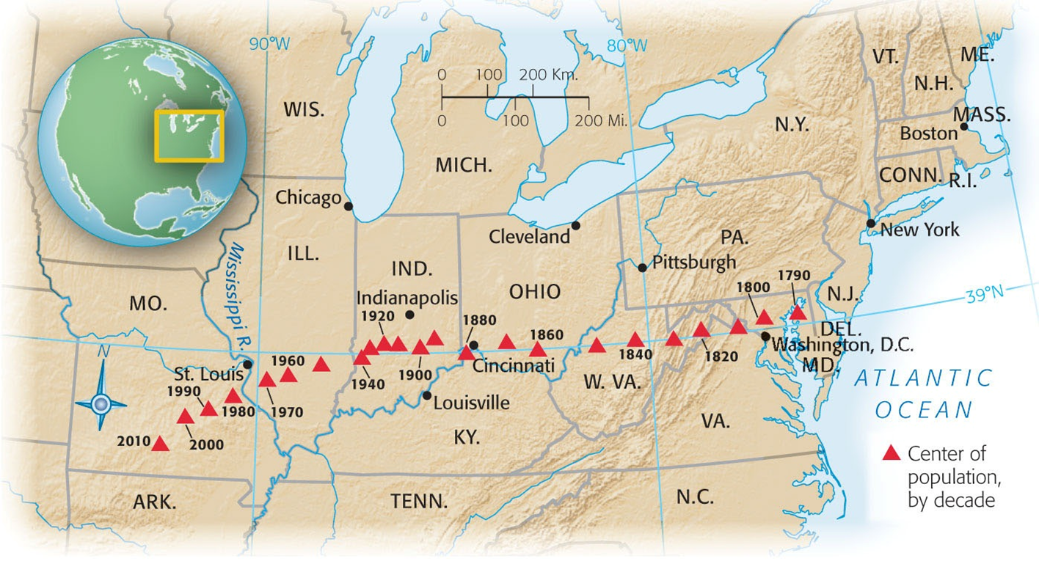
Shaping the Western Landscape
Westward movement
Fur-trappers venture from St. Louis to Rocky Mountains
Nearly eliminates beaver by 1840s
Traders along planes also threatened buffalo herds to near extinction
Such “aggressive and heedless exploitation” now referred to as ecological exploitation.
George Catlin – painter and environmentalist
Advocates for the preservation of Native American life via a deliberate national policy
Leads to Yellowstone Park in 1872.

Slide 3

Immigration (Irish)
1840s and 50s immigration skyrockets, why?
“Land of freedom and opportunity”
Abundance of land in US
Disease
Mid 1840s, potato famine strikes Ireland
¼ of country dies due to disease/hunger
“Black Forties”
Period when many Irish died/emigrated to other countries
Most lived in cities, not enough $ to move west
Jobs:
“NINA”
Canal workers – Erie Canal
Hated by “Native” Americans for “stealing” jobs due to low wages
Become a powerful political force: patronage, voting – Democrats
Tammany Hall, police departments (“Paddy wagons”)
Largest group of immigrants from 1830 to Civil War

Slide 4
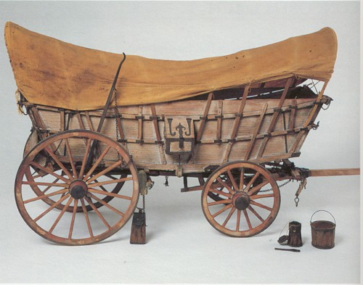
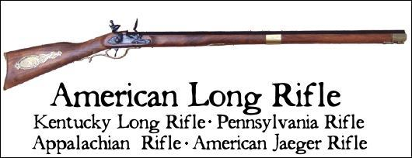
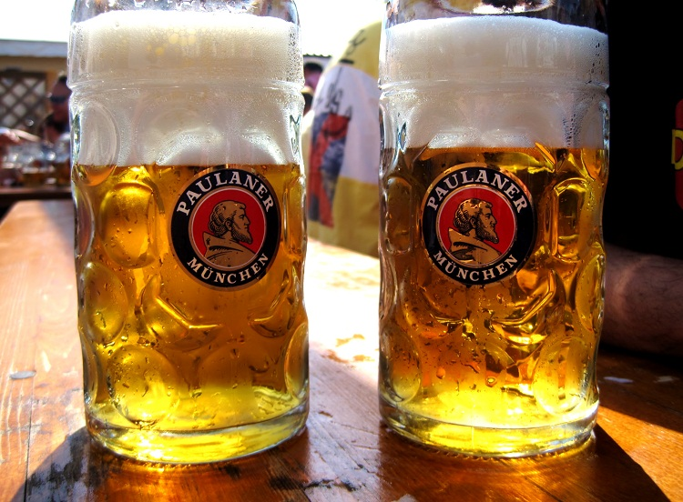
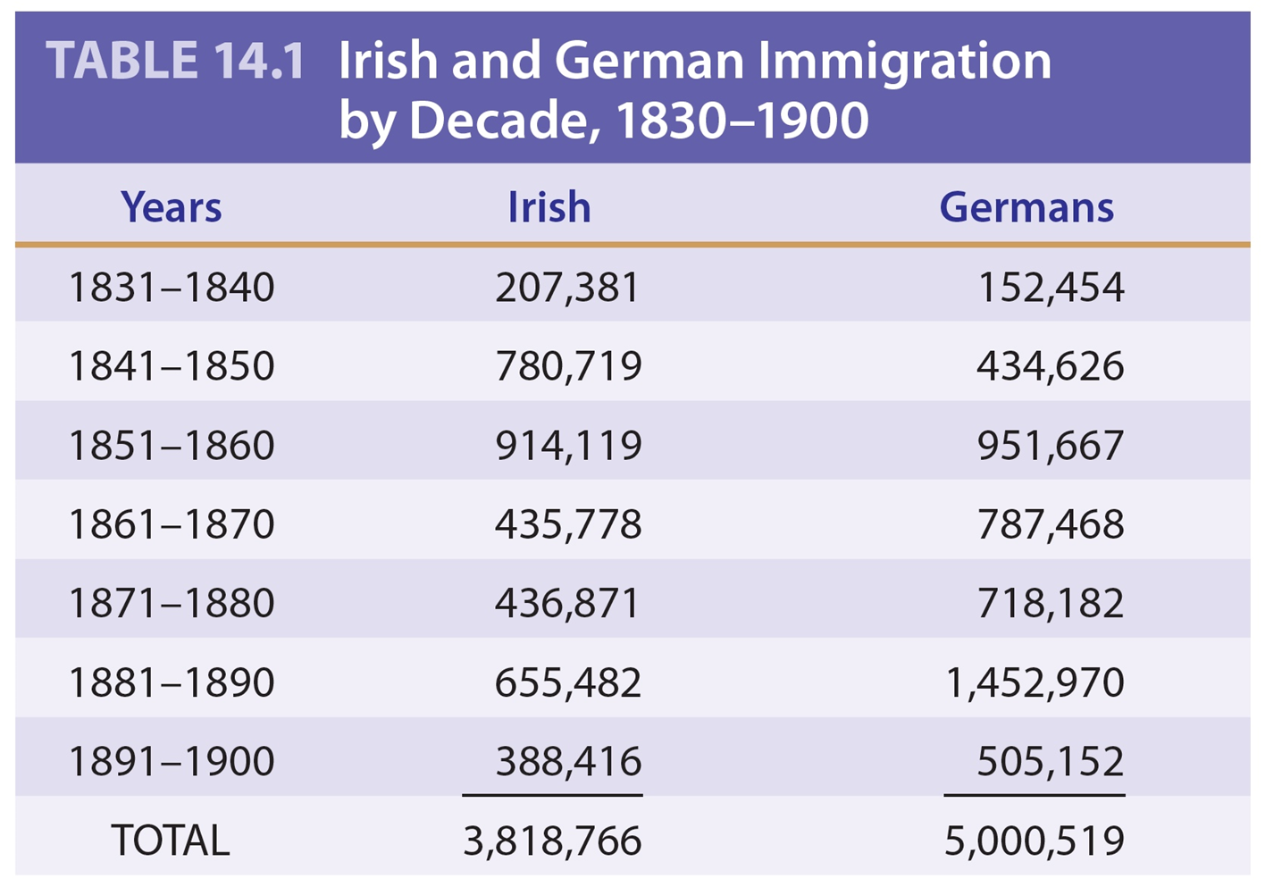
Immigration contd. (Germans)
Germans also found their way to America
The bulk were farmers looking to escape Old World rivalries and conflict
Settled in Mid-West (Wisconsin)
Contributions: Conestoga wagon, Kentucky rifle, and Christmas tree, Kindergarten, abolitionism,…
and bier (beer)

Slide 5
Nativism
“Nativists”
Hated foreigners, fear of losing culture, jobs, etc.
Religious Fears
Many Irish were Catholic, fear that would infringe on Protestantism
Catholic Church becomes largest religious faith by 1850 and never looked back
Order of the Star Spangled Banner, “Know-Nothing Party”
Political party that hoped to…
Restrict immigration and naturalization laws
Sound familiar? Practice your synthesis skills!

Slide 6
What was the “Market Revolution?”
Industrial Revolution Transportation Revolution:
Steamboat links West and South together
Roads, canals, and railroad link West and East together
Change from subsistence farming to large-scale cash-crop farming.
Regional specialization:
South grows cotton
West grows grain and livestock for East
East makes machines and textiles for West and South
Growth of cities

Slide 7
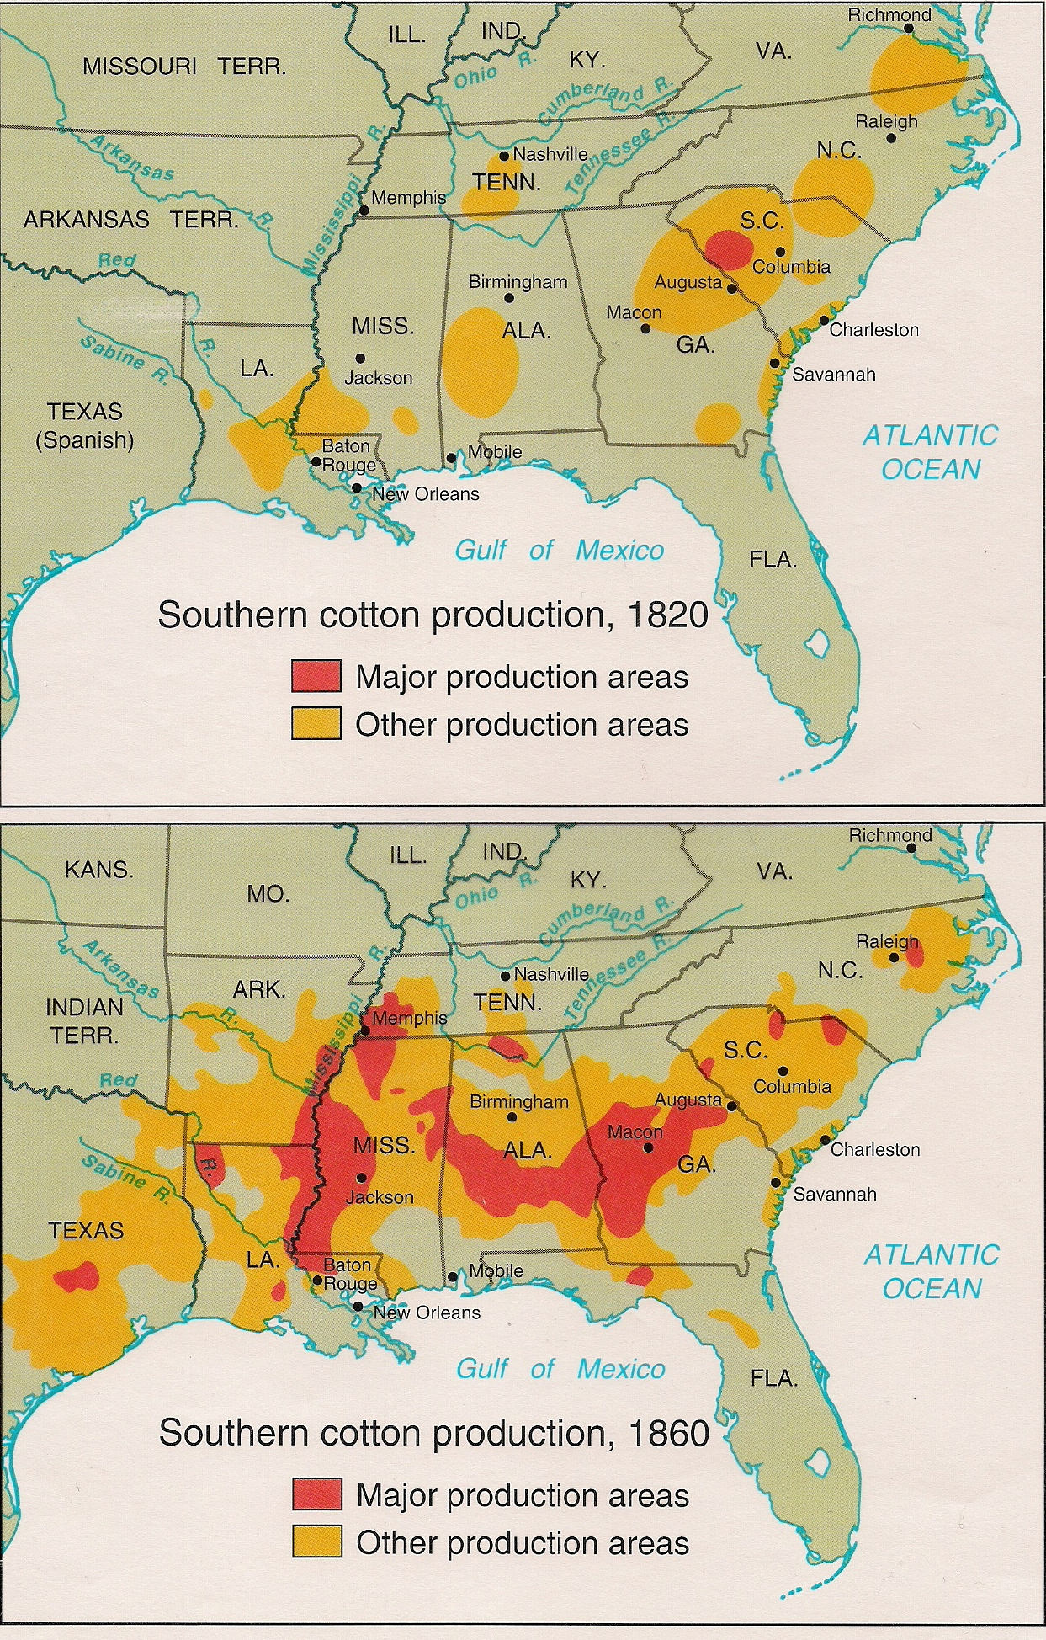
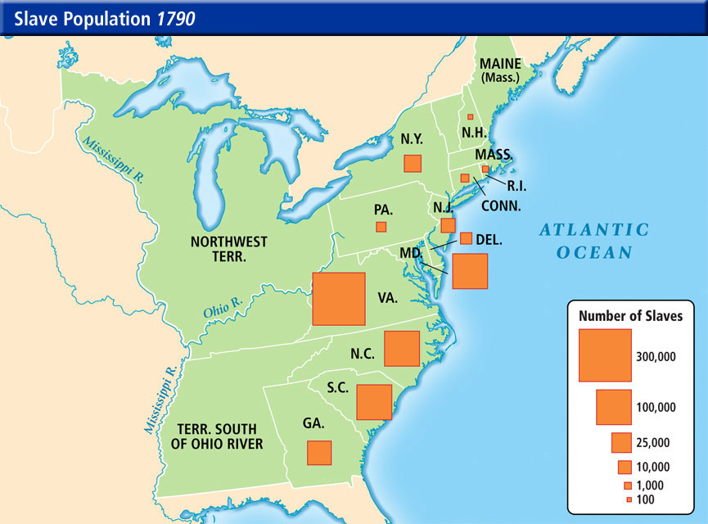
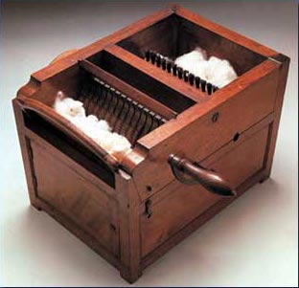
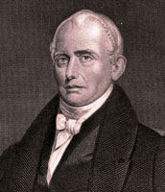
Inventions and Inventors
Samuel Slater:
“Father of Factory System”
Memorizes plans for machines, sneaks to US
Eli Whitney:
Created Cotton Gin, 50 times more effective than separating seeds
Impacts of cotton gin:
Dependence on slavery which had been dying out
Factory system in north to create clothes

Slide 8
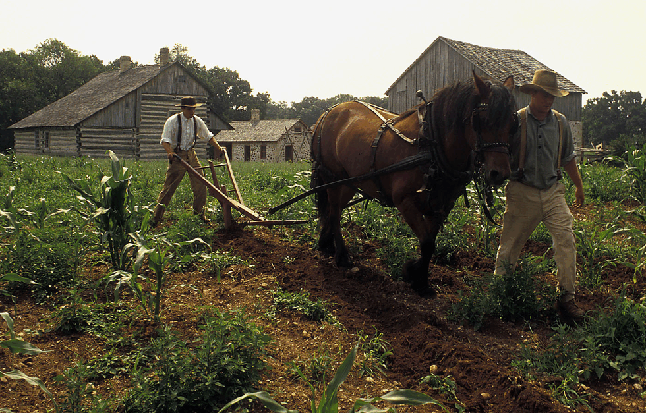

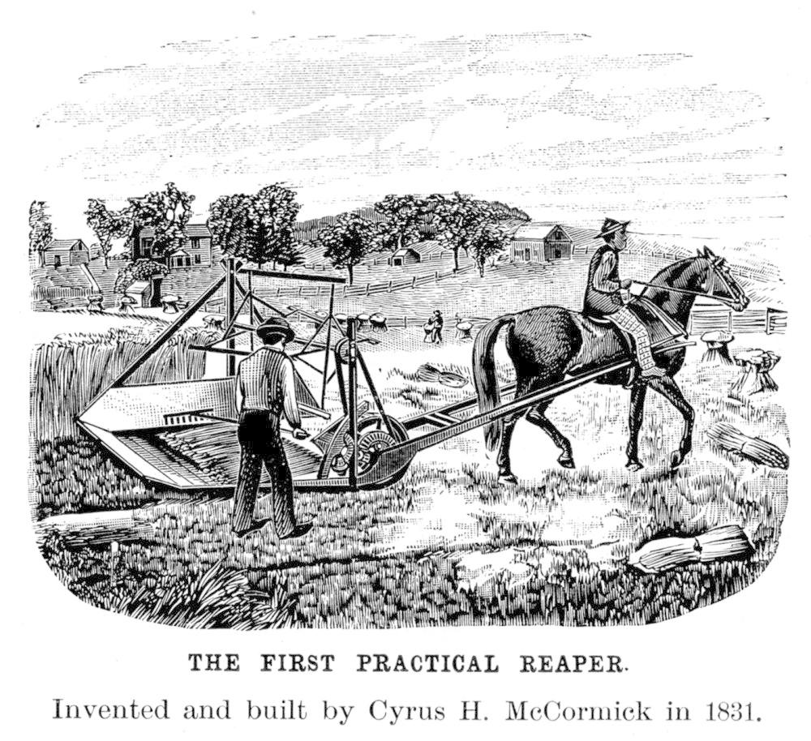
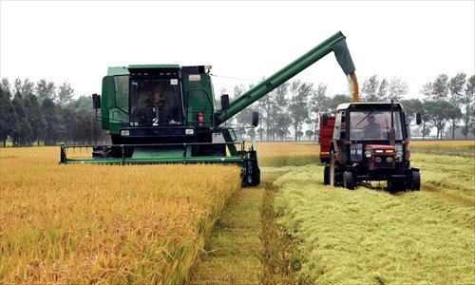
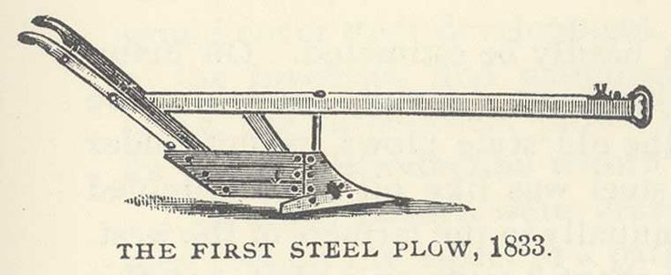
Inventions Continued
Due to embargos, Americans encouraged to “Buy American” and “Wear American”
Treaty of Ghent in 1815 opens up trade again, GB floods US with cheap products
US’ response? Tariff of 1816, first protective tariff
Who will like this? Who will hate this?
Interchangeable Parts:
Invented by Eli Whitney, machines produce identical parts, if a part breaks, it can easily be replaced
John Deere:
Invented steel plow that broke soil
Cyrus McCormick
Mechanical mower-reaper

Slide 9
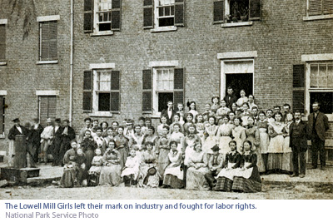
Factory Life
Factory life stunk
Long hours, low pay, child labor, “whipping rooms”
Lowell Girls:
Farmers’ daughters hired to work in factories
Significance of factories:
Change in manufacturing from home to factories
1840:
MVB establishes 10 work day for federal employees
Strikes were illegal and rare, but did happen
Commonwealth v. Hunt:
Massachusetts Supreme Court
Decision: Labor unions legal, so long as they were not violent or subversive
More symbolic than immediately significant.

Slide 10
Transportation
Cheap and efficient carriers were imperative
Why?
Desire and need to tap resources of west
Trade
Lancaster Turnpike
Connected Philadelphia to Lancaster, 62 miles
Spurs construction of other roads
By 1832, 2,400 miles of roads connecting major cities
Robert Fulton
Steam Engine, now boats could go in any direction

Slide 11
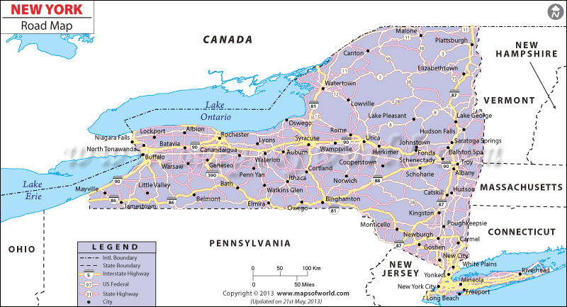
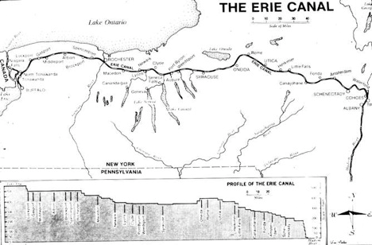
“Clinton’s Big Ditch” in NY
Erie Canal:
363 miles from Buffalo to Albany
Hudson River to Great Lakes
Cost to ship grain fell from $100 to $5; 20 days to six
Creation of many cities in NY, especially Lockport
Inrastate commerce
Synthesize forward…

Slide 12
Effects on the Union
By Civil War, continental economy had emerged
Division of Labor applied on a national scale
South: Agriculture
North/East: Factories
West: Livestock

